Slide 1
Super mart grocery sales analysis Report
The Performance Of Super Mart’s Grocery Sales Is Influenced By Factors Such As Customer Demand, Seasonal Trends, Promotional Campaigns, Product Availability, And Pricing Strategies. Analyzing These Elements Is Critical For Optimizing Inventory Management, Refining Marketing Efforts, And Maximizing Revenue. This Project Evaluates Sales Data From 2019 To 2023, Focusing On Trends Like Monthly Revenue Fluctuations, Top-performing Product Categories, Regional Sales Contributions, And Customer Purchasing Behavior. Using Excel For Data Organization And Visualization, We Developed Dashboards, Bar Charts, And Heatmaps To Uncover Actionable Insights. These Tools Help Stakeholders Identify Growth Opportunities, Streamline Operations, And Enhance Customer Satisfaction In A Competitive Retail Landscape.
-- by Shaik Naveed

Slide 2
Project overview
This project involves analyzing the sales performance of a fictional Super Mart company using Power BI. The dataset includes details such as customer orders, categories, regions, discounts, profits, and more. The goal is to uncover key business insights through interactive dashboards and visualizations that help stakeholders understand performance across regions, customer segments, and product categories.
Key objectives:
Track overall sales, profit, and discount trends
Identify top-performing categories, cities, and customers
Analyze the impact of discounts on profitability
Monitor sales over time for business forecasting

Slide 3
Technologies used
Microsoft Excel / CSV:
Source of raw data (Super Mart Sales data).
2. Microsoft Power BI:
For data modelling, DAX calculations, and creating visual dashboards.
3. DAX (Data Analysis Expressions):
Used for creating custom KPIs and metrics.
4. Power Query:
For data transformation and cleaning.

Slide 4
Problem statement
Super Mart, a large retail grocery store, accumulates a significant amount of sales data from various product categories, stores, and customer segments.
However, without proper analysis, this data remains underutilized. The objective of this project is to analyze the historical sales data to uncover key trends, identify top-performing products and categories, detect sales seasonality, and understand customer purchasing behavior.
This analysis aims to provide actionable insights to improve inventory management, optimize product placement, and enhance overall business strategies.
The final deliverables include visual dashboards and summary reports to assist management in data-driven decision-making.

Slide 5
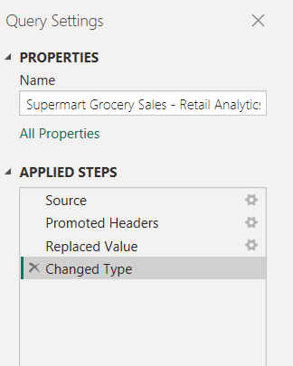
Data transformation in power query editor
Calculated Columns:
1. Quarter
2. Quarter label
Replaced Values
Changed the Data Types Of Each Column

Slide 6
DAX(Data Analysis Expression)
Created Explict Measures for Creating Custom KPI’s and Metrics
1. Total Sales
2. Total Orders
3. Total Profit
4. Total Discount
5. Average Discount

Slide 7
6. Average Sales
7. Profit Margin
8. Top 10 Customers
9. Most Profitable Sub Category
10. Running Totals

Slide 8
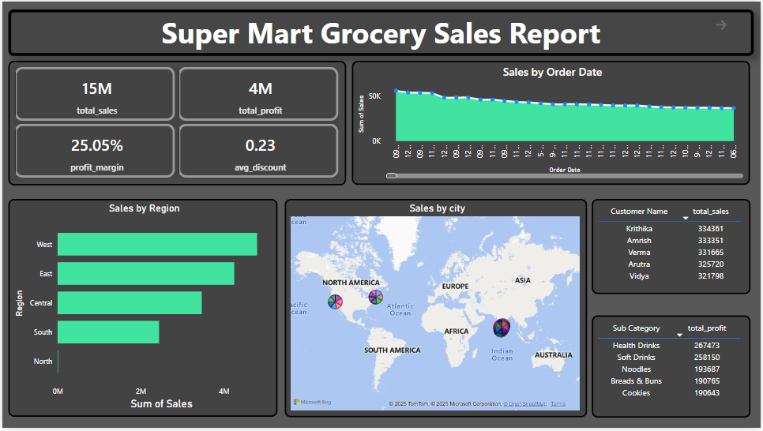
Dashboard 1
Sales Overview Dashboard

Slide 9
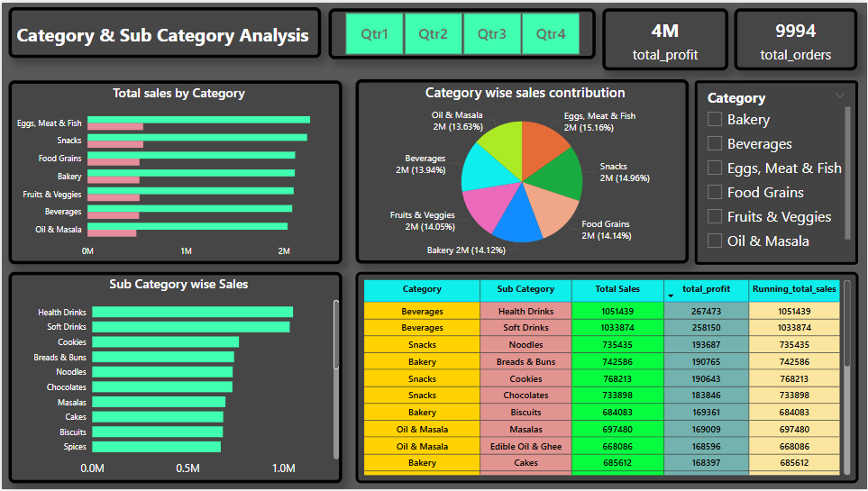
Dashboard 2
Category & Sub Category Wise Analysis Dashboard

Slide 10
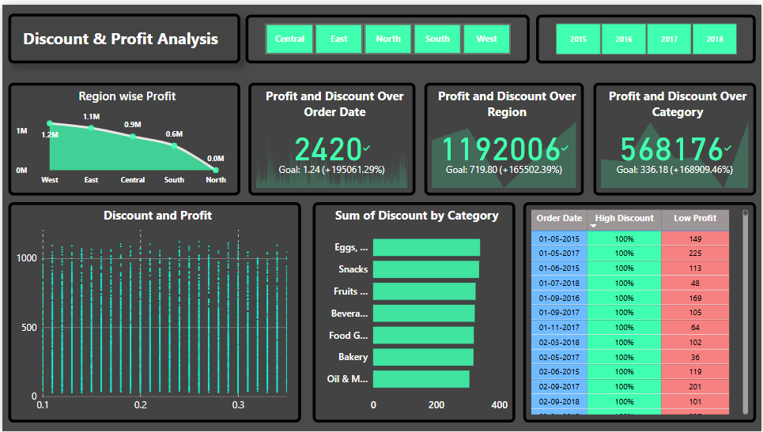
Dashboard 3
Discount & Profit Analysis Dashboard

Slide 11
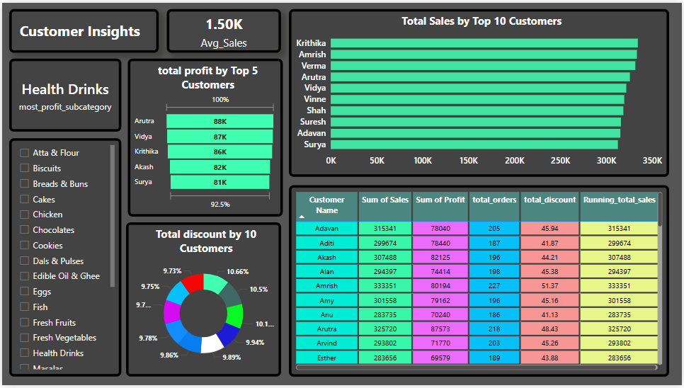
Dashboard 4
Customers Insight Dashboard

Slide 12
Summary
I developed an interactive Power BI dashboard to analyze Super Mart’s sales data, which included information such as Order ID, Customer Name, Product Category and Sub-Category, City, Region, Order Date, Sales, Discount, and Profit.
The objective was to uncover business insights by evaluating sales performance over time, identifying top-performing categories, regions, and customers, and understanding the impact of discounts on overall profitability.
Using Power BI, I created key performance indicators (KPIs) such as Total Sales, Total Profit, Profit Margin, and YoY Sales Growth with DAX measures. Visualizations included line charts for sales trends, bar charts for category-wise analysis, maps for regional performance, and scatter plots to assess the relationship between discounts and profit.
The report featured interactive slicers, drill-through capabilities, and filters to allow users to explore the data dynamically.
This dashboard empowered decision-makers with actionable insights and helped optimize sales strategy based on data-driven analysis.

Slide 13
Thank you
-- By Shaik Naveed

